Slide 1
Exercise 2
WPF - Visual C# | Handling events exercise | Simple textbox form with event-handling for OK button

Slide 2
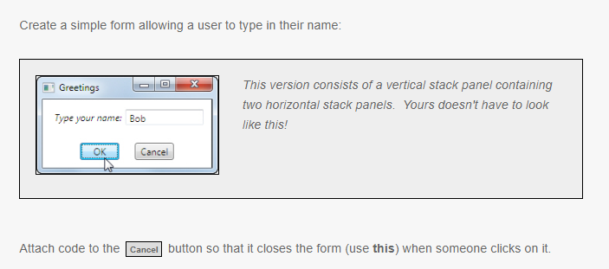

Slide 3
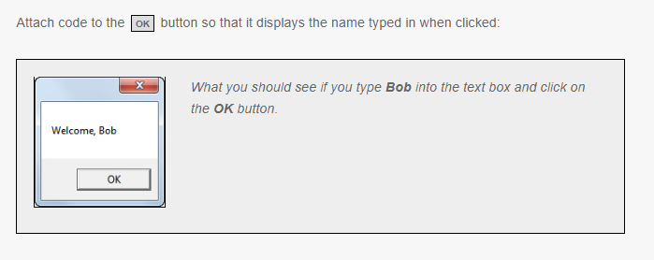

Slide 4
